Slide 1




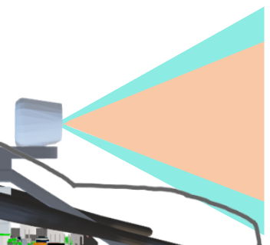

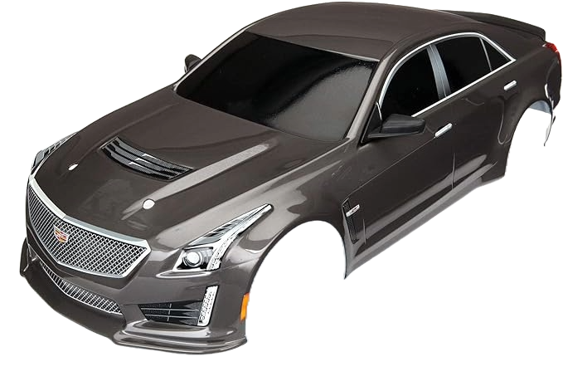




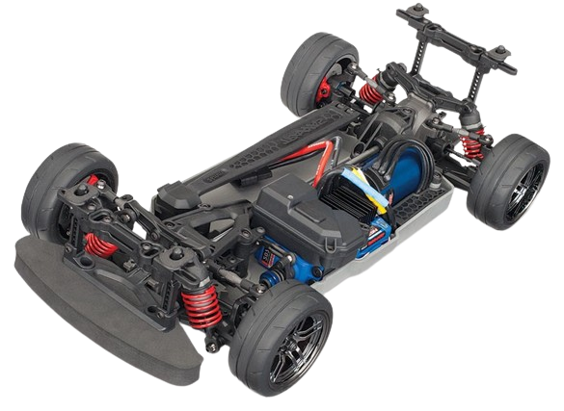


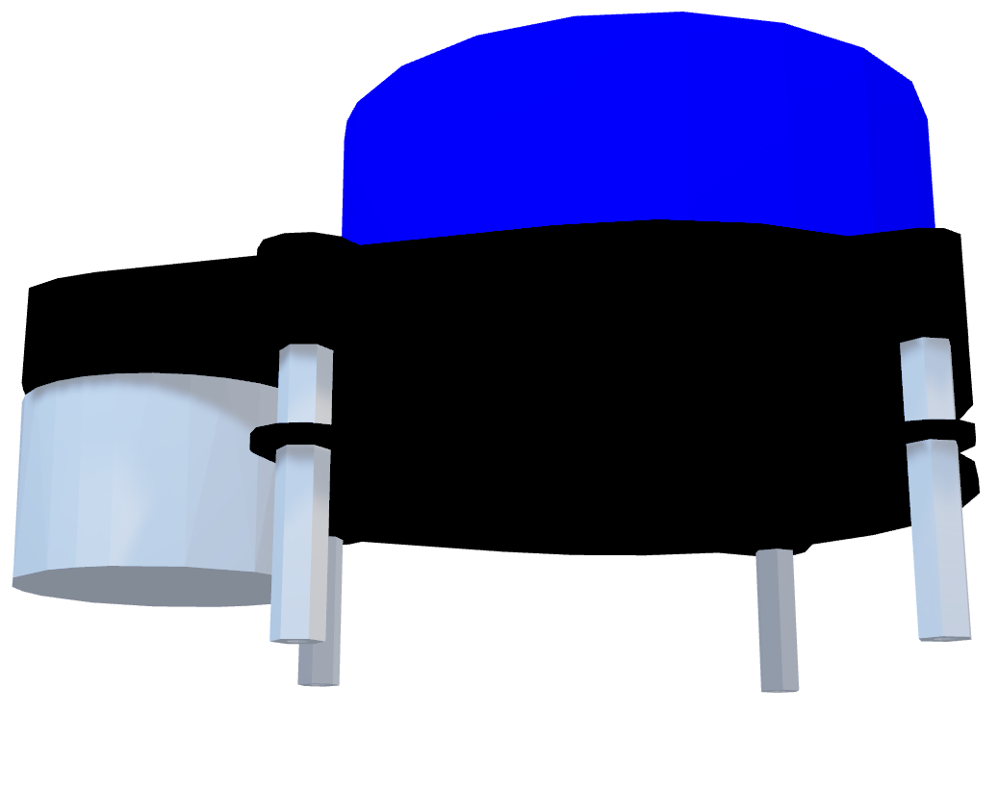
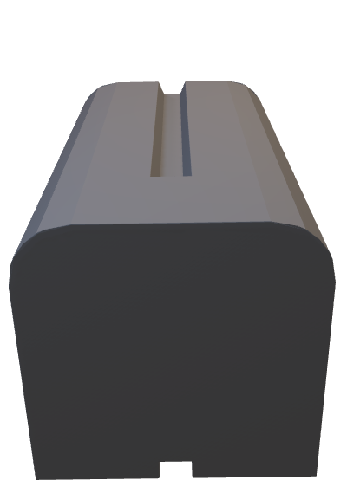
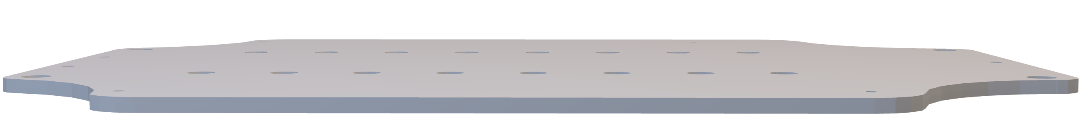
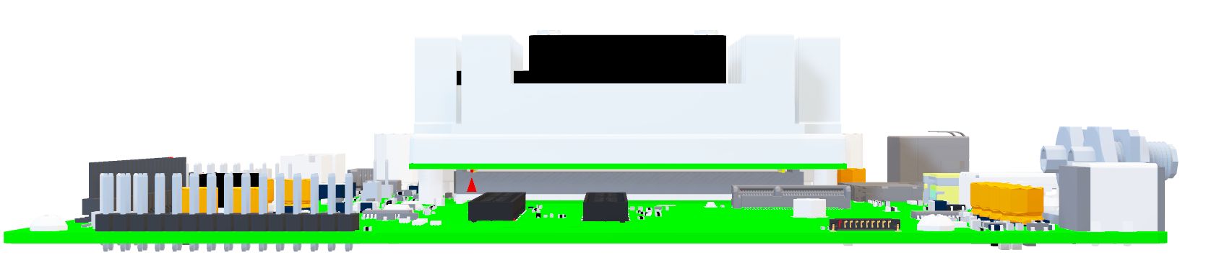
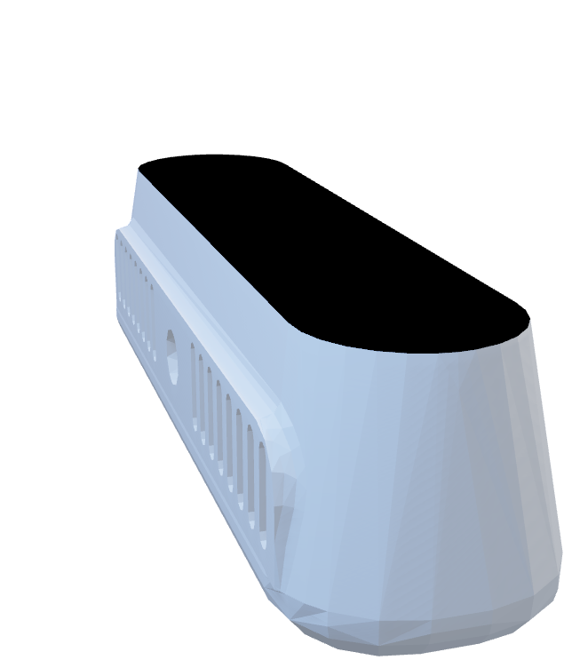
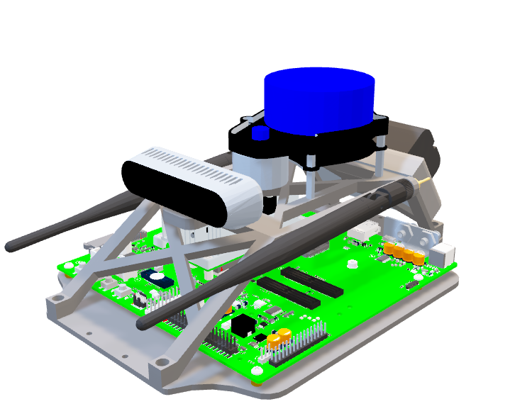
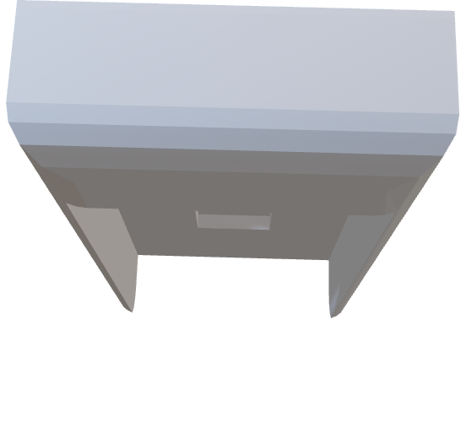
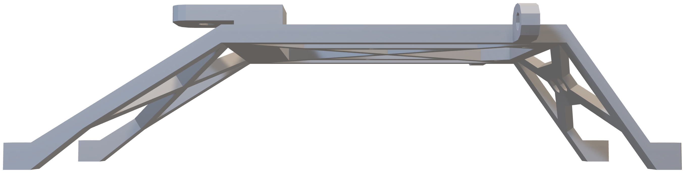
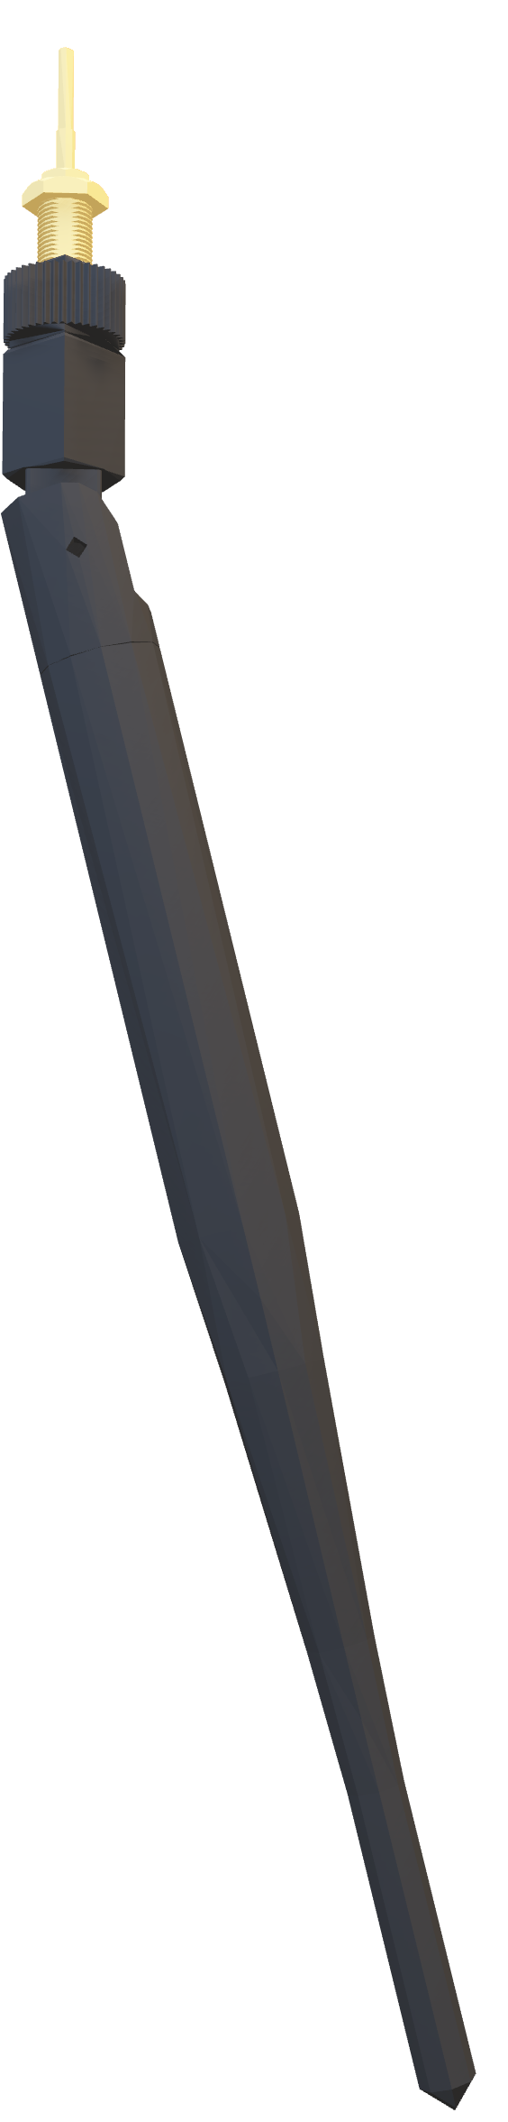
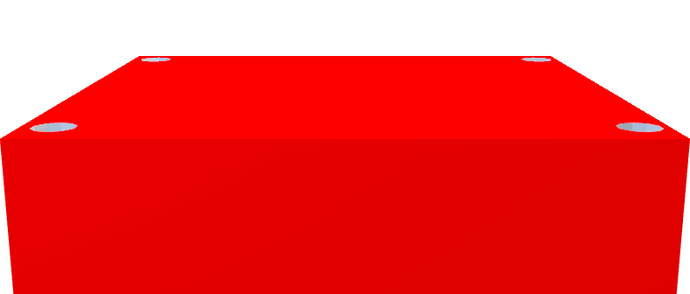
Formula 1/10th Vehicle
Team 503 | Kyle Lozano | Adam Imamura | Ja’Quan Young | Alex Soriano | Aaron Hastie
Objective
Project Background
Field of View
Create a robust 1/10th scale vehicle frame that withstands collisions and accommodates self-driving components. Ensure it adheres to specific engineering metrics for measuring effectiveness and reliability, suitable for competitive racing and classroom applications.
The F1TENTH project, an open-source autonomous racing effort, enthusiasm for autonomous systems via building, learning, racing, and research. It has built a global community of researchers, engineers, and enthusiasts dedicated to advancing autonomous technology.
Color Field of View
Depth Field of View
Design Targets
Current Design
Height Limit 18 cm
Supports Component 12N
Weight
Endures Crash Force 150 N
Limits Body-roll ±5 deg
Steer Angle ±30 deg
Stereo Camera
Roll Cage
LiDAR
WiFi Antenna
Computer
Battery
&
Adapter
Roll Cage
Target Validation
Customer Delivery Specs
Future Work
Baseplate
Speed Controller
Notes:
Goals: Among Us

Slide 2

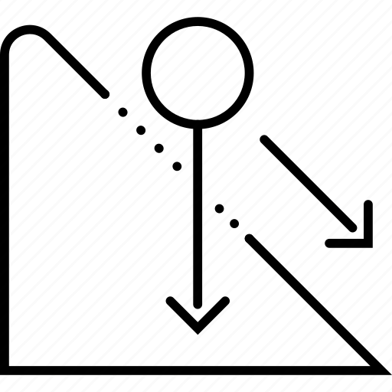

Formula 1/10th Vehicle
Team 503 | Kyle Lozano | Adam Imamura | Ja’Quan Young | Alex Soriano | Aaron Hastie
Objective
Project Background
Our project's objective is to create a robust 1/10th scale vehicle frame capable of withstanding collisions while accommodating various self-driving components. We're adhering to specific engineering standards to ensure its effectiveness and reliability.
The F1TENTH project, an open-source autonomous racing initiative, fosters excitement and interest in autonomous systems through building, learning, racing, and research. This active initiative has cultivated a thriving global community of researchers, engineers, and enthusiasts, which has experienced substantial growth since its beginning, all unified in the advancement of autonomous technologies.
Design Targets
Current Design
Height Limit
Supports Component Weight
Endures Crash Force
18 cm
12 N
150 N
Stereo-Camera
LiDAR
Roll Cage
Telemetry Antenna
Future Work
Processor
Material Analysis
Finite Element Analysis
Target Validation
Customer Delivery Specs
Battery
&
Adapter
Upper Chassis
Baseplate
Speed Controller
Notes:
Goals: Sur

Slide 3








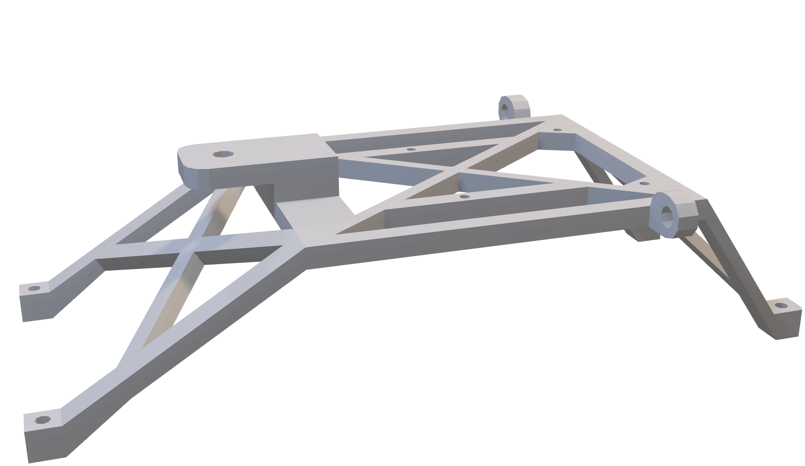
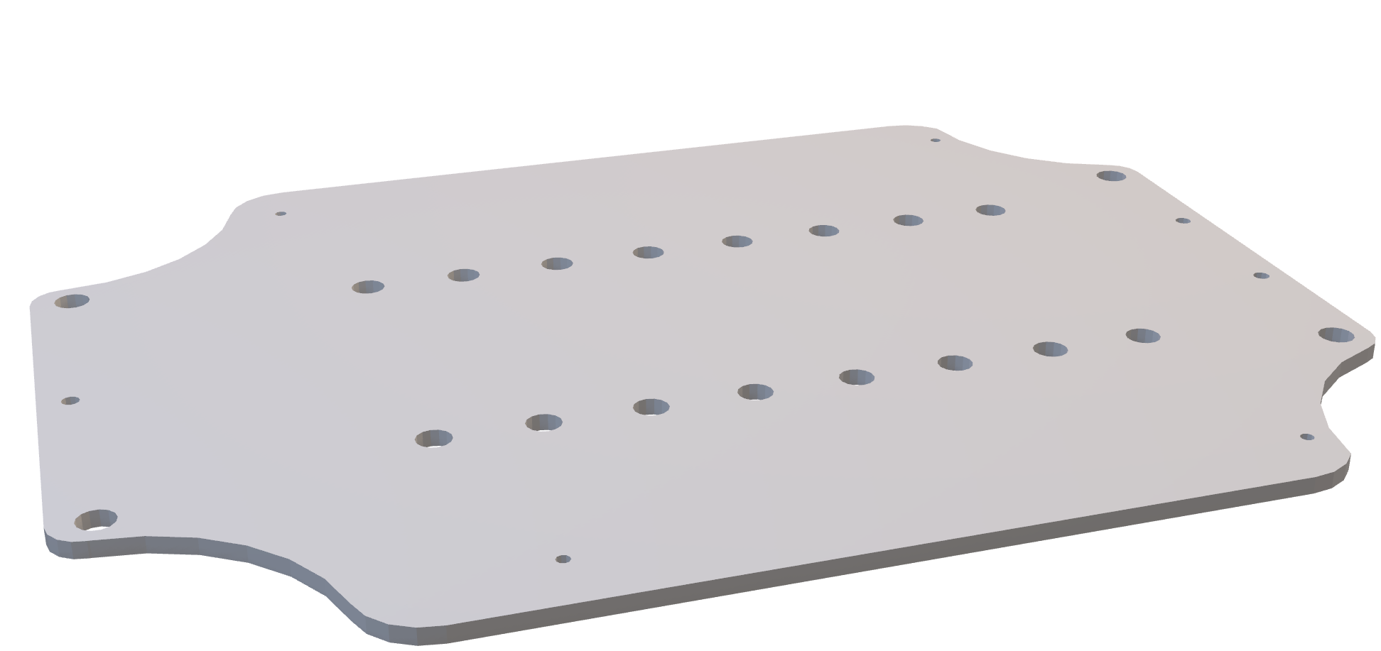
Formula 1/10th Vehicle
Team 503 | Kyle Lozano | Adam Imamura | Ja’Quan Young | Alex Soriano | Aaron Hastie
Objective
Project Background
Our project's objective is to create a robust 1/10th scale vehicle frame capable of withstanding collisions while accommodating various self-driving components. We're adhering to specific engineering standards to ensure its effectiveness and reliability.
The F1TENTH project, an open-source autonomous racing initiative, fosters excitement and interest in autonomous systems through building, learning, racing, and research. This active initiative has cultivated a thriving global community of researchers, engineers, and enthusiasts, which has experienced substantial growth since its beginning, all unified in the advancement of autonomous technologies.
Strong and Resilient
Current Design
Conveniently translatable to algorithm simulations
Replicable
Dampens Component Vibration
Unobstructed
LiDar View
Ns/m
360 deg
Design Goals
Height Limit
Supports Component Weight
Endures Crash Force
18 cm
12 N
150 N
Future Work
Material Analysis
Finite Element Analysis
Target Validation
Customer Delivery Specs
Limits Body-Roll
Steer Angle
±5 deg
±30 deg
Collision Protection
Roll-Over Protection
Port Clearance Accessibility

Slide 4
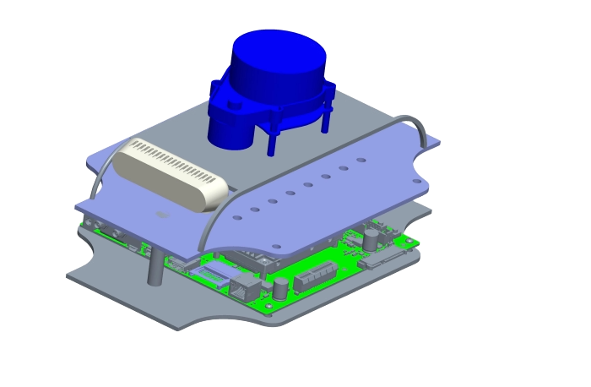
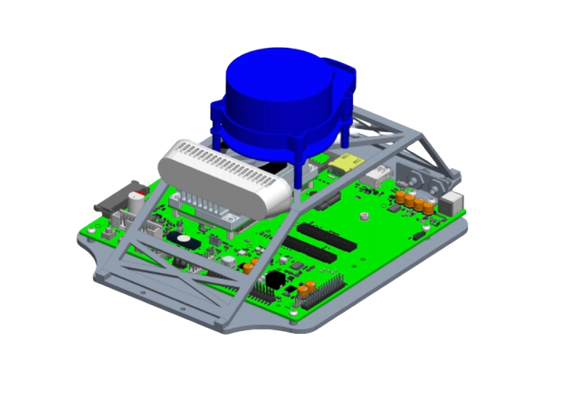
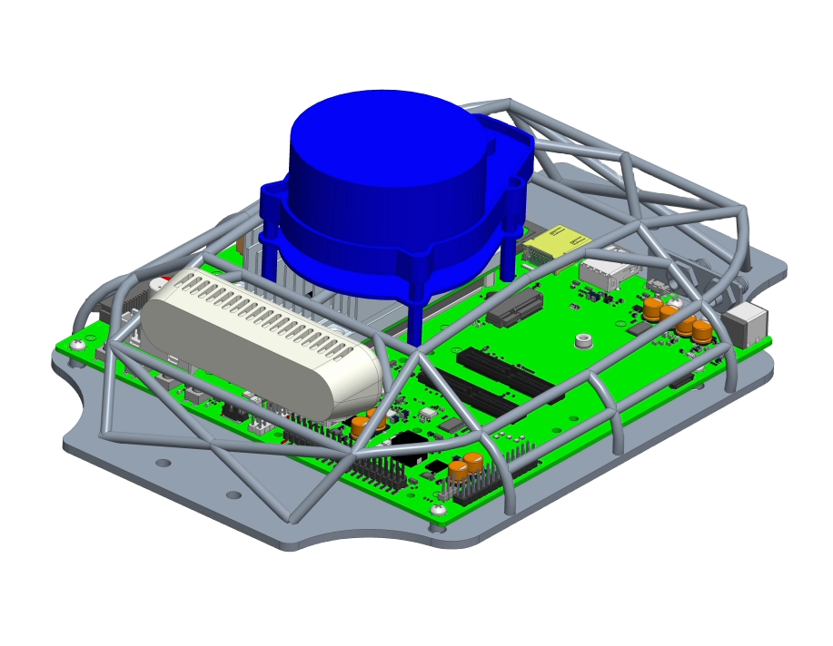
Formula 1/10th Vehicle
Team 503 | Kyle Lozano | Adam Imamura | Ja’Quan Young | Alex Soriano | Aaron Hastie
F1TENTH Body
Movement
Structure
Utilization
Protection
Objective
Project Background
Functional Decomposition
Design and fabricate a 1/10th scale competition vehicle body that can house various autonomous driving components.
The F1TENTH project is an open-source autonomous racing project that promotes interest and excitement in autonomous systems through research, learning, building, and racing.
Key Goals
Strong and Resilient
Conveniently translatable to algorithm simulations
Design Concepts
Concept 1
Concept 2
Concept 3
Easily reproducible
Roll Cage
Future Work
Order all materials
Submit parts for fabrication
Assemble the design
Perform testing and validation
Prepare for Senior Design Day

